Slide 1
Failure Analysis & Recovery
Instructor: Dr. Faisal Bahadur

Slide 2
What is a Software Failure?
A software failure is an error, flaw, mistake, or fault in software that prevents it from behaving as intended (e.g., producing an incorrect or unexpected result)
Software failures are also known as software errors or software bugs

Slide 3
Effects of Software failure
Bugs can have a wide variety of effects, with varying levels of inconvenience to the user of the software. Some bugs have only a subtle effect on the program’s functionality and may thus lie undetected for a long time. More serious bugs may cause the software to crash or freeze leading to a denial of service.
Others qualify as security bugs and might for example enable a malicious user to bypass access controls in order to obtain unauthorized privileges.
The results of bugs may be extremely serious from bankruptcy, loss of economy up to loss of lives.

Slide 4
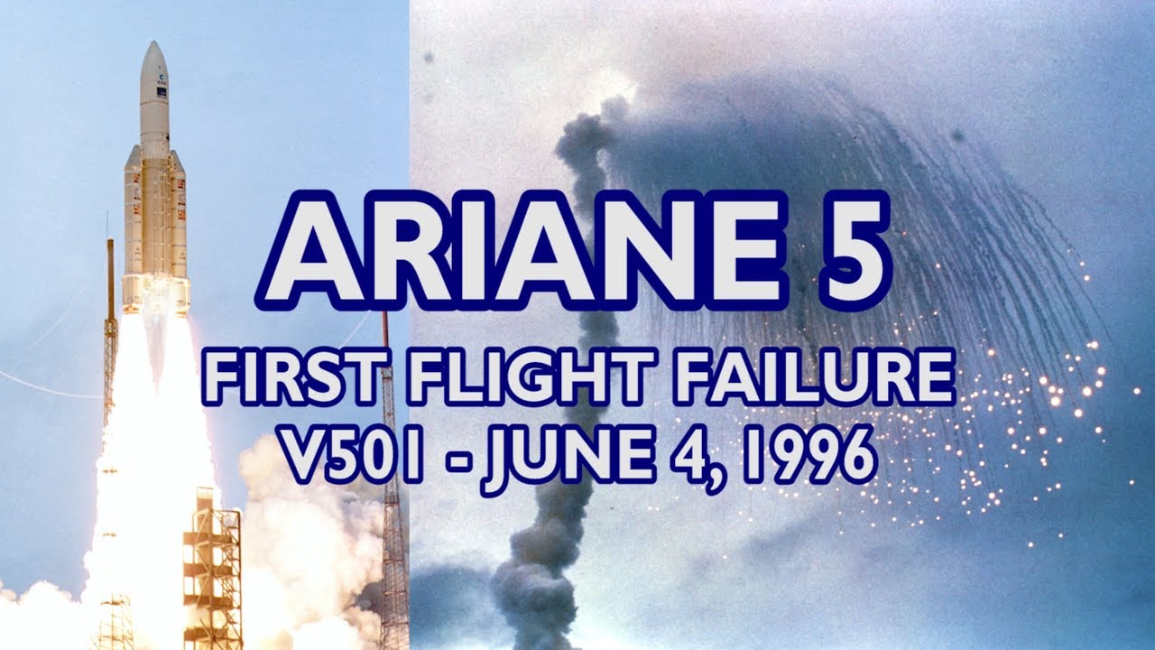
ARIANE 5 ROCKET DESTRUCTION
In 1996, the European Space Agency’s US $1 billion prototype Arian 5 rocket was destroyed less than a minute after launch, due a bug in the on-board guidance computer program
Notes:
Attempting to fit 64 bits into a 16-bit variable flipped the Ariane 5 rocket 90 degrees in the wrong direction, causing it to self-destruct mid-launch. This is considered one of the most expensive computer bugs in history.
This story is a good reminder that assumptions in old code can lead to unexpected consequences when applied to a different situation.

Slide 5
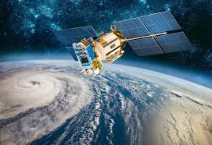
Mars Climate Orbiter burns up in space
Mistakenly using Imperial rather than Metric units caused the incorrect calculation of a spacecraft’s trajectory, leading it to ultimately lost in space, and finally reported burn up in the atmosphere.

Slide 6
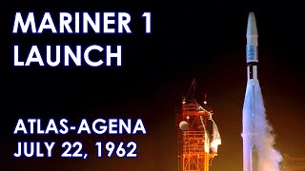
The Mariner 1 Spacecraft
On a mission to fly-by Venus in 1962, due to s/w-coding error caused the rocket to veer dangerously divert(from path), threatening to crash back to earth. Alarmed, NASA engineers on the ground issued a self-destruct command. A review board later determined that the omission of a hyphen in coded computer instructions allowed the transmission of incorrect guidance signals to the spacecraft. The cost for the rocket was reportedly more than $18 million at the time.

Slide 7
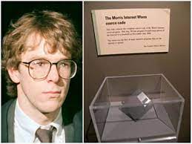
The Morris Worm
A program developed by a Cornell University student spreading wildly and crashing thousands of computers in 1988 because of a coding error. It was the first widespread worm attack on the fledgling Internet. The graduate student, Robert Tappan Morris, was convicted of a criminal hacking offense and fined $10,000.
Costs for cleaning up the mess may have gone as high as $100 Million.
Notes:
Morris is now a professor at the Massachusetts Institute of Technology. A disk with the worm’s source code is now housed at the museum of University of Boston.

Slide 8

Knight’s $440 Million Error
One of the biggest American market makers for stocks struggled to stay afloat after a software bug triggered a $440 million loss in just 30 minutes.
At 09:00AM, the New York Stock Exchange opened for trading, and Knight Capital’s first retail investor of the day placed an instruction to buy or sell their investment holdings.
Just 45 minutes later, Knight Capital’s servers had executed 4 million trades, losing the company $460 million and placing it on the verge of bankruptcy.
Notes:
Unfortunately, an incorrect algorithm deployed on one of Knight’s production servers was designed to do the opposite calculations on buying and selling.

Slide 9
Effects of Software failure - 5
In 2002, a study commissioned by the US Department of Commerce’ National Institute of Standards and Technology concluded that software bugs are so prevalent and detrimental that they cost the US economy and estimated US $59 billion annually, or about 0.6 percent of the gross domestic product

Slide 10
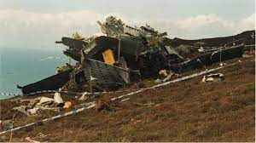
Effects of Software failure - 4
In June 1994, a Royal Air Force Chinook crashed into the Mull of Kintyre, killing 29 people. An investigation uncovered sufficient evidence to convince that it is caused by a software bug in the aircraft’s engine control computer

Slide 11
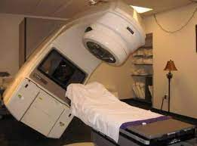
Effects of Software failure - 6
1987 : Therac-25 – The Bug that killed
Radiation machine for patients of cancer that measures B.P, temperature, sugar level heart-beat salt level. Based on the input data a proper amount of radiation is give, Nut due to the coding error the wrong amount was given to patient that killed some people at initial stage of this machine. Later the failure was discovered and removed,.
Notes:
The most tragic computer bug story is about Therac-25, a machine meant to deliver radiation therapy to cancer patients. However, race conditions in the codebase and a lack of hardware safety features caused radiation overdoses that led to 3 deaths.

Slide 12
Effects of Software failure - 7
1990: AT&T long distance break down
Notes:
AT&T said that a logic error in its computer software caused the nine-hour long-distance line failure that jammed an estimated 50 million calls and also affected 800 service numbers and computer lines.

Slide 13
Effects of Software failure - 8
1991: Patriot Missile defense system – Hitting own
barracks, leaving 28 dead and
98 wounded.
Notes:
Sometimes, the cost of a software glitch can’t be measured in dollars. In February of 1991, a U.S. Patriot missile defense system in Saudi Arabia, failed to detect an attack on an Army barracks. A government report found that a software problem led to an inaccurate tracking calculation that became worse the longer the system operated. On the day of the incident, the system had been operating for more than 100 hours, and the inaccuracy was serious enough to cause the system to look in the wrong place for the incoming missile. The attack killed 28 American soldiers. Prior to the incident, Army officials had fixed the software to improve the Patriot systems accuracy. That modified software reached the base the day after the attack.

Slide 14
Soviet Gas Pipeline Explosion
The Soviet pipeline had a level of complexity that would require advanced automated control software.
Working with the Canadian firm that designed the pipeline control software, the CIA had the designers deliberately create flaws in the programming so that the Soviets would receive a compromised program.
It is claimed that in June 1982, flaws in the stolen software led to a massive explosion along part of the pipeline, causing the largest non-nuclear explosion in the planet’s history.

Slide 15
Software Bug Origins
Errors in Requirements
Errors in Design
Errors in Source code
Errors in User Documentation
Errors due to “Bad fixes”
Errors in Data and Tables
Errors in Test Cases

